Slide 1

Ddos attack detection
Using Machine Learning Algorithms
Alperen Budak Batuhan Duyuler Merve Duru
040150017 040150046 040150107

Slide 2
Problem Statement
What is DDoS attack?
Distributed Network Attacks are known as Denial of Service (DDoS) attacks.
Such attacks take advantage of certain capacity limits that apply to any network resource, such as the infrastructure that provides a company's website.
A DDoS attack aims to exceed the capacity of the website to process multiple requests and prevent them from working correctly by sending multiple requests to the attacked web resource.
What is our aim?
Our goal is to detect DDoS attacks using machine learning algorithms by following internet traffic.

Slide 3
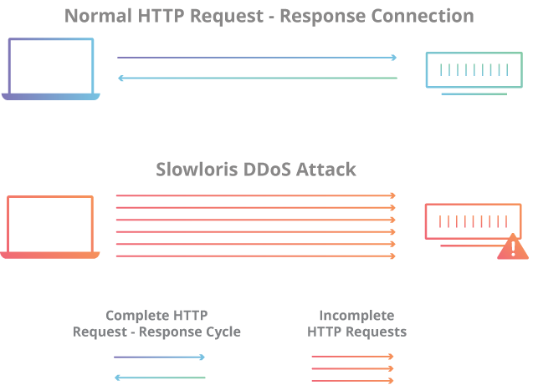
Types of DDoS Attacks
DDoS Hulk
DDoS Slowloris

Slide 4
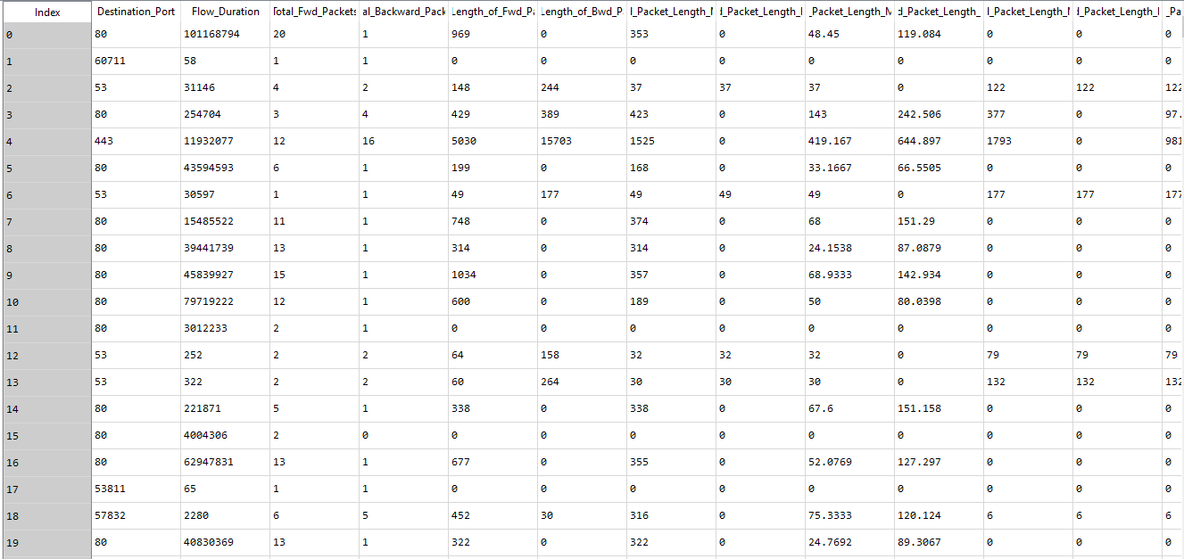
Analysis of Data

Slide 5

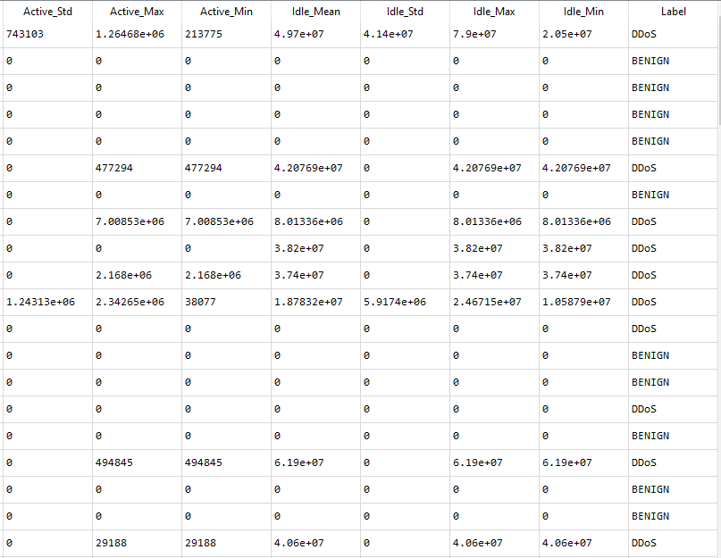
Supervised Learning
Classification:
KNN
SVM

Slide 6
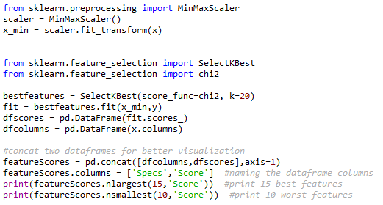
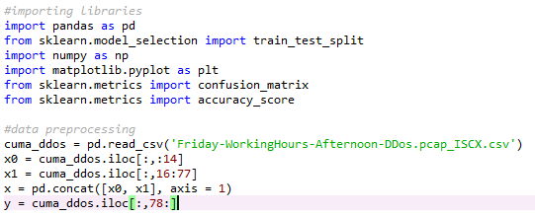
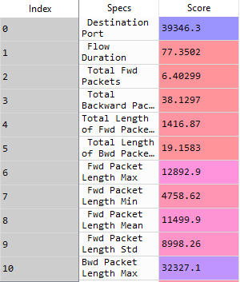
Libraries are imported
Since the data took a long time to process and
overfitting occured, feature selection was done.

Slide 7
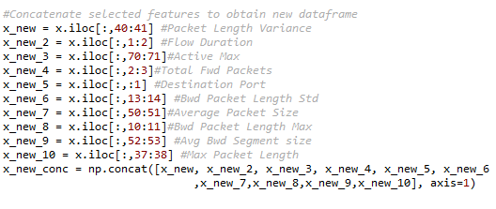
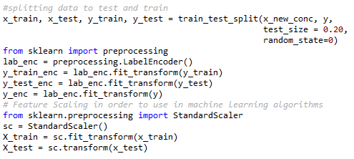
After selecting new features, we concatenated to obtain new set.
Then, we splitted new set to train and test data sets.
Moreover label names converted to integers using label encoder.
Before learning, we scaled training and test sets with standard scaler
in order to get efficient results.

Slide 8
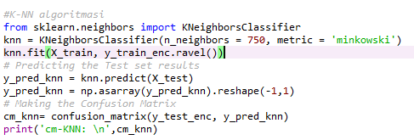
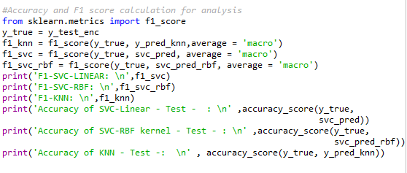
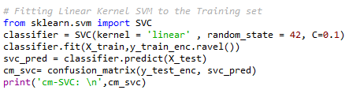
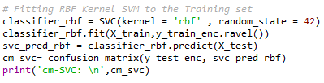

Slide 9
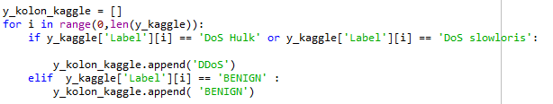
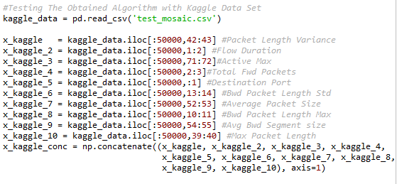
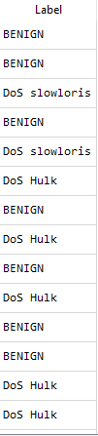

Testing the Obtained Model with Kaggle Data set
In order to test another data with obtained model,
preprocessing is done.
Then the number of DoS attack labels reduced to 1
which is ’’DDoS’’.

Slide 10
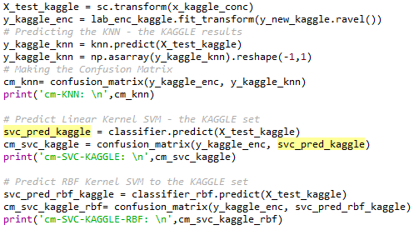
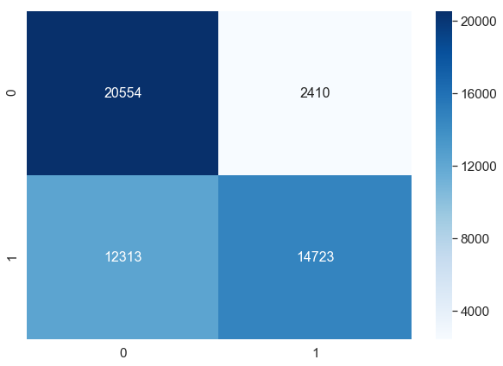
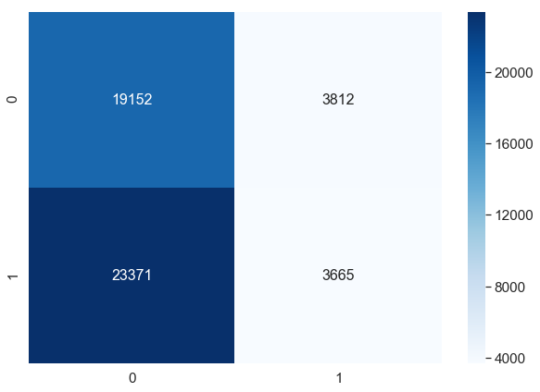
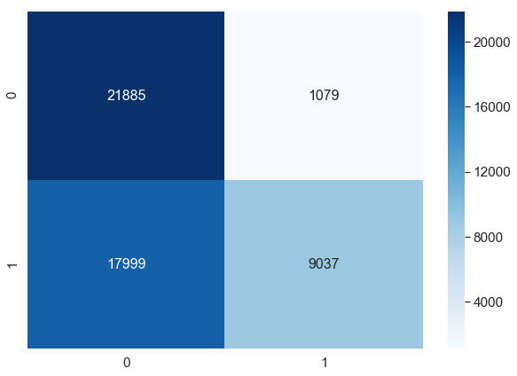
Confusion Matrix of KNN
Confusion Matrix of SVC - Linear
Confusion Matrix of SVC – Kernel (RBF)
So we tested kaggle network traffic data
with our model then obtained confusion matrixes
We did not fit the data, only predicted with
algorithm. predict

Slide 11
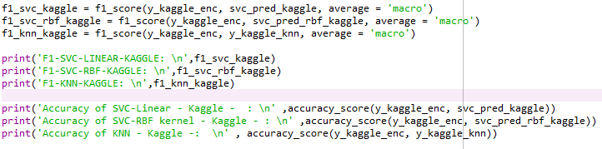
Obtaining Results for Kaggle Data
For kaggle set, as seen in the graph, the model predicted worse than friday afternoon test set.
Next we test our data for Monday working hours data set to see how much our model is reliable.
Then we tried to improve our predictions in order to obtain more reliable model.

Slide 12
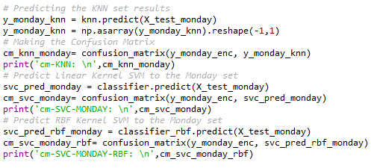
Testing the Obtained Model with Monday Data set
In Monday network traffic data set, there is no DDoS attacks.
Hence the prediction by our model gets hard due to a different circumstance.

Slide 13
Comparison of KNN F1-score for different # neighbours
When we increased the number of neighbours in KNN model, F1-score increased for kaggle network traffic data set.
However for the Monday data set F1-Score decreased.

Slide 14
Comparison of Models for all data sets
F1-SCORE
ACCURACY
When we compare the models, when #neighbour = 750, the model which have best performance is kernel svm

Slide 15
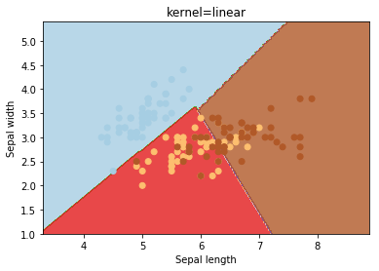
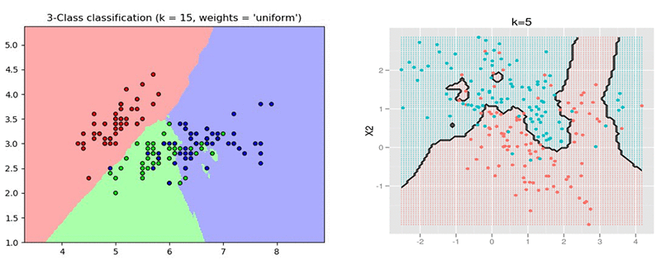
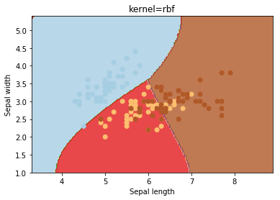
The reason why rbf and knn is effective more than
linear kernel, is these two models perform better in nonlinear
seperated data sets.

Slide 16
How can we improve?

Slide 17

Focusing on Port 80

Slide 18
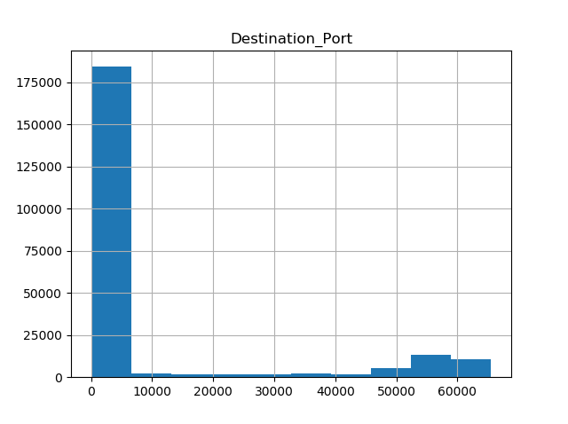
Destination Port Distribution For Friday Data Set

Slide 19
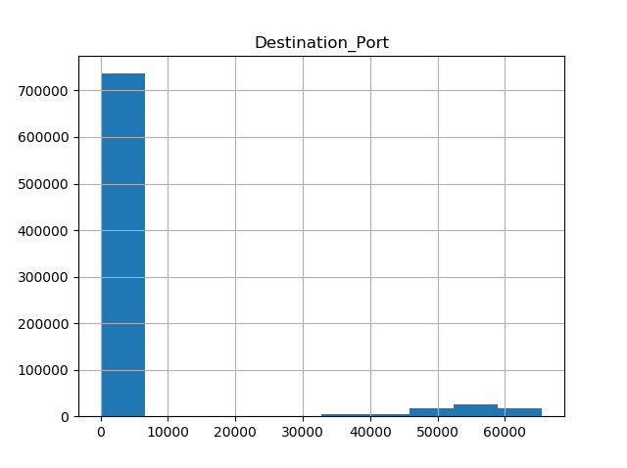
Destination Port Distribution For Keagle Data Set

Slide 20

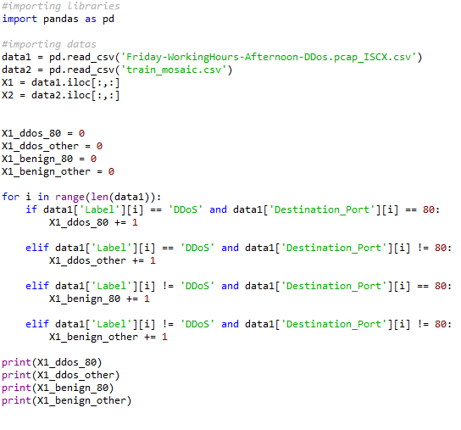
Finding DDoS Attacks Ratio on Port 80

Slide 21
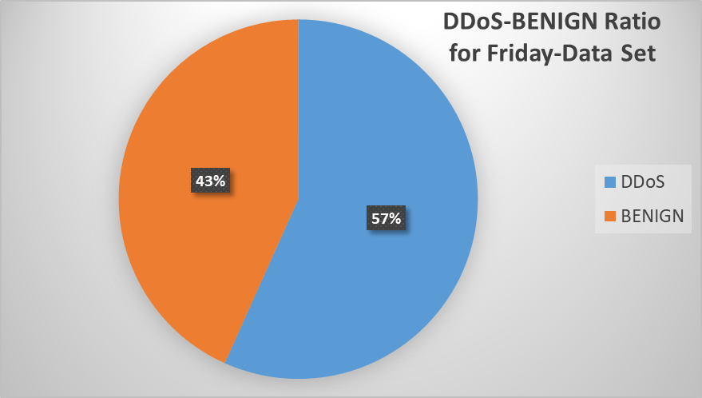
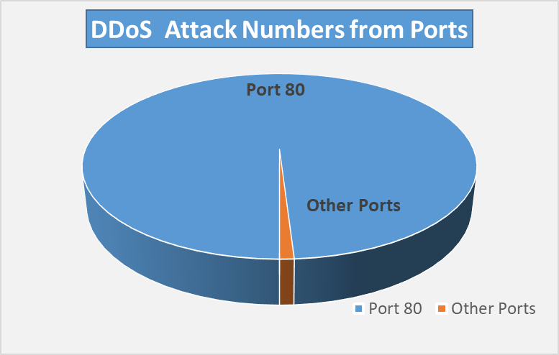
# of DDoS Packets | # of Benign Packets
128.027 | 97.718
Only 3 of them are not on Port 80.
 | Port 80 | Other Ports
DDoS | 128.024 | 3
BENIGN | 8.927 | 88.791

Slide 22

# of DDoS Packets | # of Benign Packets
438.738 | 370.623
 | Port 80 | Other Ports
DDoS | 438.738 | 0
BENIGN | 35.543 | 335.080
None of them are on other ports.
KNN train model (second) | SVC - linear (second) | SVC - rbf (second) | total - train ( second) | total - train ( minute ) | memory(avg) | Interpreter
45,2 | 366 | 290 | 701,2 | 11,68666667 | 960 Mbytes | Spyder

Slide 23
REFERENCES
https://www.kaggle.com/wardac/applicationlayer-ddos-dataset
Iman Sharafaldin, Arash Habibi Lashkari, and Ali A. Ghorbani,
“Toward Generating a New Intrusion Detection Dataset and Intrusion Traffic Characterization”,
4th International Conference on Information Systems Security and Privacy (ICISSP),
Portugal, January 2018
3. https://ieeexplore.ieee.org/document/8697702
https://www.cloudflare.com/learning/ddos/what-is-a-ddos-attack/
https://scikit-learn.org/stable/modules/svm.html
https://pandas.pydata.org/pandas-docs/stable/reference/api/pandas.DataFrame.html
https://docs.scipy.org/doc/numpy/reference/generated/numpy.asarray.html

Slide 24
Thanks for listening!

